Slide 1
Age prediction from brain EEG signals
Presented by
Emmanouil Anagnostakis
Konstadinos Spiridakis

Slide 2
Overview
Task
Statistical analysis
Data preprocessing
Prediction Models
Results
Conclusions

Slide 3
The problem
The purpose of this project is to predict person’s age through normal patient’s EEG signals.
EEG are signals extracted from a Electroencephalography (EEG), a monitoring method to record electrical activity on the scalp.
Note that EEG signals in combination with machine learning (ML) approaches were not commonly used for the human age prediction.

Slide 4
… and the needs
We investigated
whether age-related changes are affecting brain EEG signals
prediction of chronological age using various machine learning prediction models belonging to both regression and classification categories

Slide 5
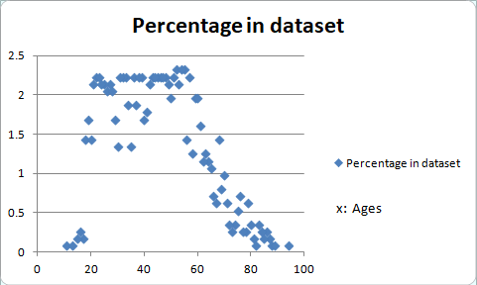
Statistical Analysis

Slide 6
Data preprocessing
Clear dataset from headers and check for empty shells
Check zero feature dispersion and eliminate those columns/features
Balancing our dataset
Scaling training data
Normalizing training data

Slide 7
Models
Regression
Random Forest
Decision tree
Gradient Boosted Tree
Factorization machines
Survival
Linear
Classification
Random Forest
Decision tree
Logistic Regression
Factorization machines

Slide 8
Reasons for model rejection
Overfitting
Classification performed better than regression
Lack of hyperparameters
Model not designed to perform well with our dataset
Error not improving by trying a variety of parameters in the model

Slide 9
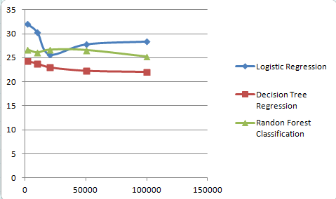
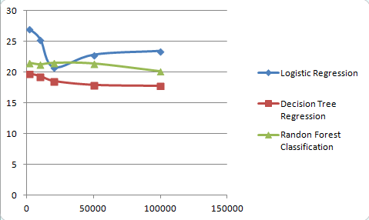
Evaluation
x: Dataset Rows
x: Dataset Rows
y: RMSE
y: MAE
There is room for a lot of improvement on the predictions, which could be a really good topic for research

Slide 10
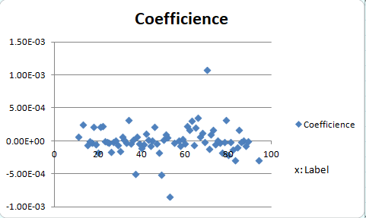
Logistic Regression

Slide 11
Bibliography
Predicting Age From Brain EEG Signals—A Machine Learning Approach
Authors: Obada Al Zoubi, Chung Ki Wong, Rayus T. Kuplicki, Hung-wen Yeh, Ahmad Mayeli, Hazem Refai, Martin Paulus and Jerzy Bodurka
Methods of EEG Signal Features Extraction Using Linear Analysis in Frequency and Time-Frequency Domains
Authors: Amjed S. Al-Fahoum1 and Ausilah A. Al-Fraihat

Slide 12


